Slide 1
GAME DEVELOPED
BY PYTHON
GROUP -3
Ishanjit Nandi
Pritam Paul
Rishikesh prasad
Aparupa Mukherjee

Slide 2
WHAT IS PYTHON
Python is a high-level computer programming language often used to build websites and software, automate tasks, and conduct data analysis. Python is a general-purpose language.

Slide 3
INTRODUCTION
We basically made a game that quite similar to Candy crush.The objective of the game is to swap adjacent candies to form a chain of three or more of the same color, which then disappear, allowing new candies to fall into their place. The game is divided into levels, and each level has a specific goal that the player must achieve to progress to the next level

Slide 4
PROBLEM STATEMENT
There is a need for an engaging, addictive, and easy-to-learn puzzle game that can be played on multiple platforms, including mobile devices and social media. The game should have a colorful and visually appealing design, with intuitive gameplay mechanics that are accessible to a wide range of players. The game should also have a system of rewards and achievements that incentivizes players to continue playing and progressing through the levels.

Slide 5
CHALLENGES
# create the game window & fixed candy’s position on the board.
# Snap the positions of two candies on the board.
# Display score and moves.
# Update the candies on the board list.
# Check the drop candies if it’s the same color.
# Animate the matching candies shrinking.

Slide 6
SOLUTION APPROACH
‣ Use variables to assine board size , candy size.
‣ We use __inti__ function for set candy’s positions on the board.
‣ And we resolve many problem in basically by using functions.
‣ For animation we have created a while loop.

Slide 7
LIBRARIES USED
Import random The random module is a built-in module in Python that provides a suite of functions for generating pseudo-random numbers. The import random statement at the beginning of a Python script or interactive session loads the random module into memory, making the functions it provides available for use within that script or session.
Some of the common functions provided by the random module include:
random(): generates a random float between 0 and 1
randint(a, b): generates a random integer between a and b (inclusive)

Slide 8
Import pygame Pygame is a Python module that is used for game development and multimedia applications. It provides a set of Python functions and classes that enable the creation of games and other multimedia applications, such as interactive art installations, simulations, and educational software.
Pygame is built on top of the SDL library, which is a cross-platform library for creating multimedia applications. Pygame provides an easy-to-use API for handling graphics, sound, user input, and game logic. Some of the key features provided by Pygame include:
Sprite and sprite group management
Collision detection
Sound and music playback
Input handling (keyboard, mouse, joystick)
Drawing and rendering graphics (shapes, images, text)

Slide 9
from pygame.locals import The line from pygame.locals import * is a common way to import a set of constants and enums from the pygame.locals module into your Python code.
The pygame.locals module contains a large number of constant values that are used by Pygame to represent things like keyboard keys, mouse buttons, event types, and video modes. By importing these constants using the * syntax, you can use them in your code without having to prefix them with the pygame.locals module name.

Slide 10
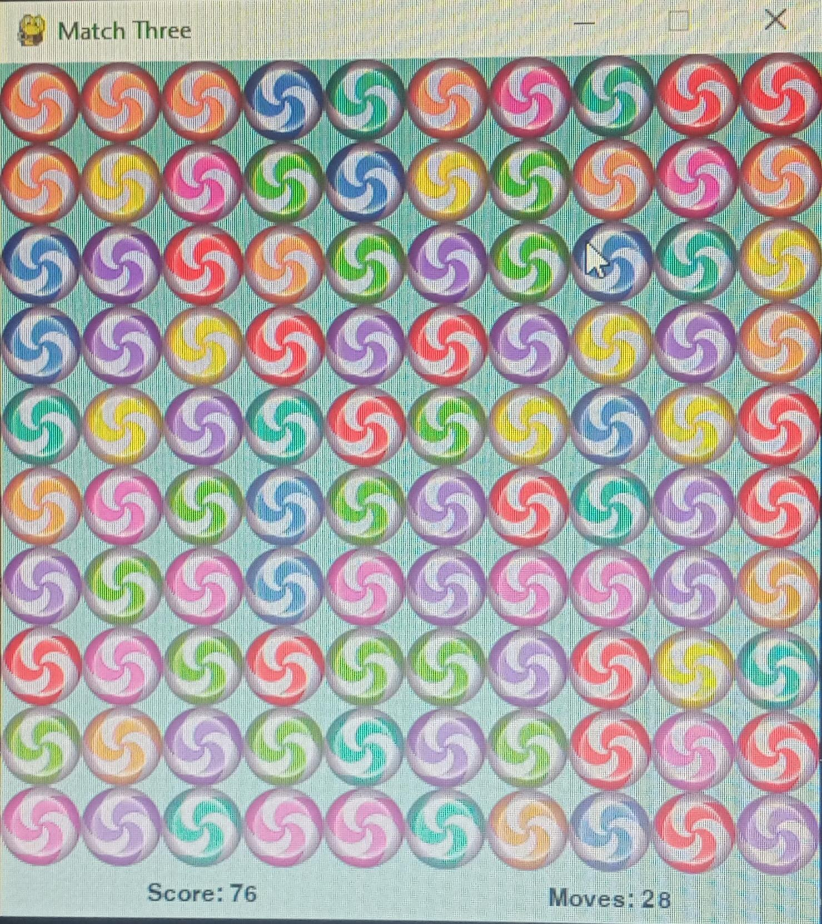
GAME INTERFACE

Slide 11
OBSERVATION
1.Game design principles: You would need to think about the mechanics and rules of the game, such as how candies are matched, how power-ups work, and how the player progresses through levels. This would involve applying principles of game design, such as balancing challenge and reward, providing clear feedback to the player, and creating a sense of progression and achievement

Slide 12
2.Object-oriented programming: To create a game like Candy Crush, you would likely use object-oriented programming concepts to represent the different game elements, such as candies, game boards, and score counters. You would create classes for each of these elements and use methods to define their behavior and interactions with other objects in the game.
3.Algorithms and data structures: Candy Crush involves a lot of pattern matching and manipulation of game boards and candies, which would require the use of algorithms and data structures such as arrays, lists, and dictionaries.
We shall create classes for each of those elements and

Slide 13
and use methods to define their behavior and interactions with other objects in the game.
3.Algorithms and data structures: Candy Crush involves a lot of pattern matching and manipulation of game boards and candies, which would require the use of algorithms and data structures such as arrays, lists, and dictionaries. You would need to use these tools to detect matching candies, move them around the game board, and track the player's progress and score.
4.User interface design: The user interface of Candy Crush is a key part of its appeal, with its colorful graphics, animations, and sound effects.Creating a similar user interface would involve

Slide 14
designing and implementing elements such as game boards, candy sprites, and graphical effects like explosions and cascading candies.
5.Game development best practices: Creating a game like Candy Crush would involve following best practices for game development, such as modular code design, testing and debugging, and optimization for performance and memory usage. You would also need to consider factors such as game balancing, monetization strategies, and user engagement metrics in order to create a successful and enjoyable game.

Slide 15
RESULTS
PROJECT NAME : Game developed by python
Contribution :
Ishanjit Nandi->Program making,PPT making
Pritam Paul->Documents making
Rishikesh Prasad
Aparupa Mukharjee
github link :https://github.com/Ishanjit357/CANDYCRUSH.git

Slide 16
CONCLUSION
Developing a Candy Crush program using Python and a game development library like Pygame can be a great way to learn and practice various programming concepts, such as object-oriented programming, algorithms and data structures, user interface design, and game development best practices.
Throughout the development process, one can learn how to apply game design principles to create a fun and engaging game experience, and how to use programming tools and techniques to implement the game mechanics and features.

Slide 17
Moreover, presenting the developed Candy Crush program can be a great opportunity to showcase one's programming skills and creativity, and to receive feedback from peers and experts in the field. It can also inspire others to learn and explore the world of game development and programming.
Overall, developing and presenting a Candy Crush program can be a challenging and rewarding experience, and can help one build valuable skills and knowledge that can be applied to many other programming projects in the future.

Slide 18
Thank You

